Slide 1
Retailer Inventory Management System
Batch: PG-DAC September 2020
Guided By: - Mrs. Bakul Joshi
Submitted By:
1. Gajendra S Pawane (200943081026)
2. Awdesh R Prajapati (200943081012)
3. Akshay G Bhujang (200943081004)
4. Shubham A Borse (200943081016)

Slide 2
Introduction
Retail managers have shifted from traditional(Paper based System) merchandise inventory control methods to computerized merchandise control systems.
Traditional system is too slow and cannot provide update lists of stocks or inventory within a reasonable time frame.
The intentions of the system is to ensuring you carry merchandise that shoppers want, with neither too little nor too much on hand.
By managing inventory, retailers meet customer demand without running out of stock or carrying excess supply and this system will be helpful for both retailers and wholesalers to maintain track record of Selling and purchase of their stocks.

Slide 3
Objective
The main objective of this project is to building a web based application which will help Retailers
& wholesaler to manage their inventory for different types of product efficiently and to get an idea about
EOQ (Economic Order Quantity) and inform about reorder level. This system also helps to overcome out
of stock problems and helps to improve Profit margins which will result in simplifies the process and
facilitate the growth. System will also provide forecasting report of different stock which will help retailer
to manage their inventory accordingly.

Slide 4
Business Requirements
Retailer Inventory Management System is the web based application.
India is the fastest growing retail market in the world which helps all types of retailers from small scale to large.
There are mainly three types of users wholesaler, Retailer & Admin
Create a Centralized Record of All Products
Retailer can keep a track of the products available in the stock
The Retailer can make an economic order quantity report of the product.
Retailer can reorder from particular whole seller.

Slide 5
Modules
Retailer Module
Retailers can register and create his own account.
Retailer Inventory Management System provides the function which allows Retailers to track their inventory and reorder level
Retailer can update the stock Information
On the basis Products availability, Retailers can purchase from the Whole seller .
Retailers can generate detailed inventory reports about Products.

Slide 6
Modules
Whole Seller Module
Whole seller can register and create his own account.
Whole seller can track the Purchase order of the retailers.

Slide 7
Modules
Admin Module
Admin is a super user who can access all the functions of the system.
System can manage products ( add, update & delete )
Admin can able to track all the retailers and whole sellers.
Admin can generate transaction Report within time frame.

Slide 8
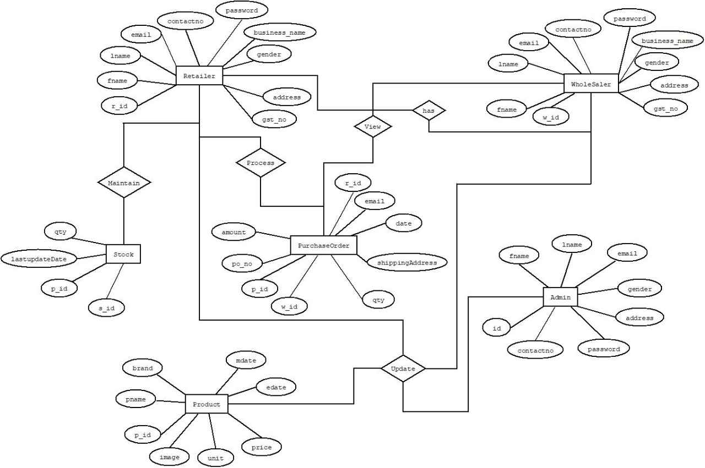
ER-DIAGRAM

